Slide 1
Casino Management System
By: S.W.A.G. (Society of Worth Assessing Gentlemen)
Team Members: Henry Felerski (team manager), Chris Reeves, Andrew Gantenbein, Sullivan Cain, Tanner Hoerter

Slide 2
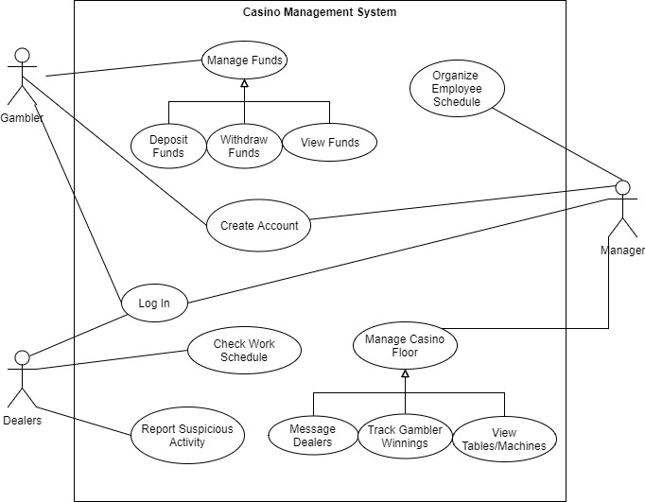
Use Case Diagram

Slide 3
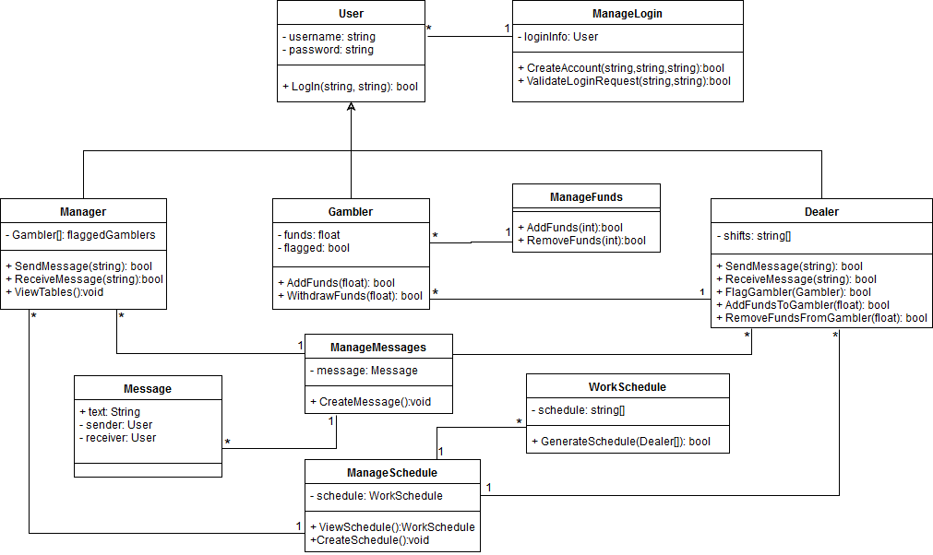
Class Diagram

Slide 4
Robustness Diagram

Slide 5
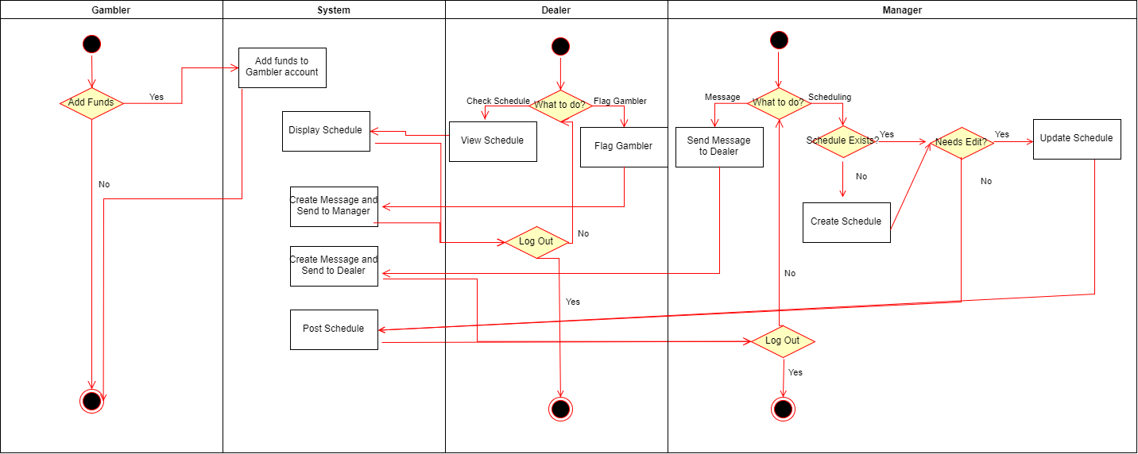
Activity Diagram

Slide 6
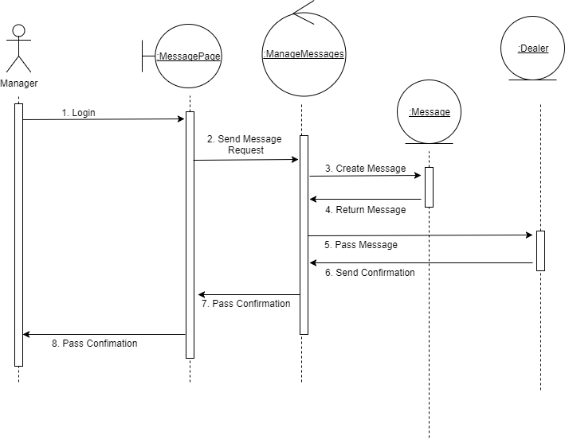
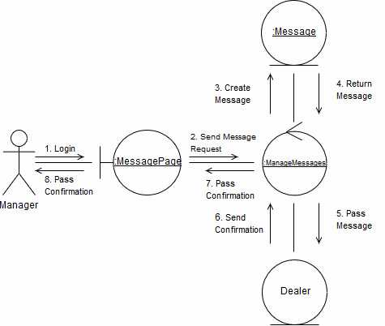
Sequence and Collaboration Diagram: Message

Slide 7
Why a casino management system?
Original idea of gambling
More practical than a game
Didn’t seem outrageously difficult
Great way to focus on communication
Between classes
Between people
Team was in agreement

Slide 8
Why change from C++ to c#?
Memory management
Delete p does not delete p
Conceptualizing during implementation
Much easier in C#
More fresh in the minds of main coders

